Slide 1

MINOR PROJECT
SOLAR TRACKING SYSTEM
Team Leader:- Ishika Srivastava
Team Members:-
Saloni Goswami
Syed Usama Meer
Tanmay Srivastava
Project Guide:-
Rohit Rathor Sir

Slide 2
INTRODUCTION
Solar energy is an unlimited source of energy which if harnessed properly will get the mankind devoid of using the conventional sources of energy he has been long using. This project has been designed keeping this in view to make the harnessing of solar energy more efficient.
SOLAR PANEL
A photovoltaic module is a packaged, connect assembly of typically 6x10 photovoltaic solar cells. Photovoltaic modules constitute the photovoltaic array of a photovoltaic system that generates and supplies solar electricity in commercial and residential applications. Each module is rated by its DC output power under standard test conditions , and typically ranges from 100 to 365 Watts (W). The efficiency of a module determines the area of a module given the same rated output – an 8% efficient 230 W module will have twice the area of a 16% efficient 230 W module. There are a few commercially available solar modules that exceed efficiency of 22% and reportedly also exceeding 24%. A single solar module can produce only a limited amount of power; most installations contain multiple modules. A photovoltaic system typically includes an array of photovoltaic modules, an inverter, a battery pack for storage, interconnection wiring, and optionally a solar tracking mechanism. The most common application of solar panels is solar water heating systems.

Slide 3
TECHNICAL USED
Arduino is an open source computer hardware and software company, project, and user community that designs and microcontroller kits for building digital devices and interactive objects that can sense and control objects in the physical world. The project's products are distributed as open-source hardware and software, which are licensed under the GNU Lesser General Public License or the GNU General Public License permitting the manufacture of Arduino boards and software distribution by anyone. Arduino boards are available commercially in preassembled form, or as do-it-yourself kits. The name Arduino comes from a bar in Ivrea, Italy, where some of the founders of the project used to meet. The bar was named after Arduino of Ivrea, who was the margrave of the March of Ivrea and King of Italy from 1002 to 1014.
POWER SUPPLY
A power supply is an electronic device that supplies electric energy to an electrical load. The primary function of a power supply is to convert one form of electrical energy to another. As a result, power supplies are sometimes referred to as electric power converters.

Slide 4
STEPPER MOTOR
A stepper motor or stepping motor is a dc brushless electric motor that divide a full rotation into a display device is an output device for presentation of information in visual or tactile form. When the input information is supplied has an electrical signal, the display is called an electronic display number of equal step. The motor’s position can then be commanded to move and hold at one of these steps without any position sensor for feedback as long as the motor is carefully sized to the application in respect to torque and speed.
DISPLAY
A display device is an output device which is for presentation of information in visual or tactile form. When the input information is supplied has an electrical signal the display is called an electronic display.

Slide 5
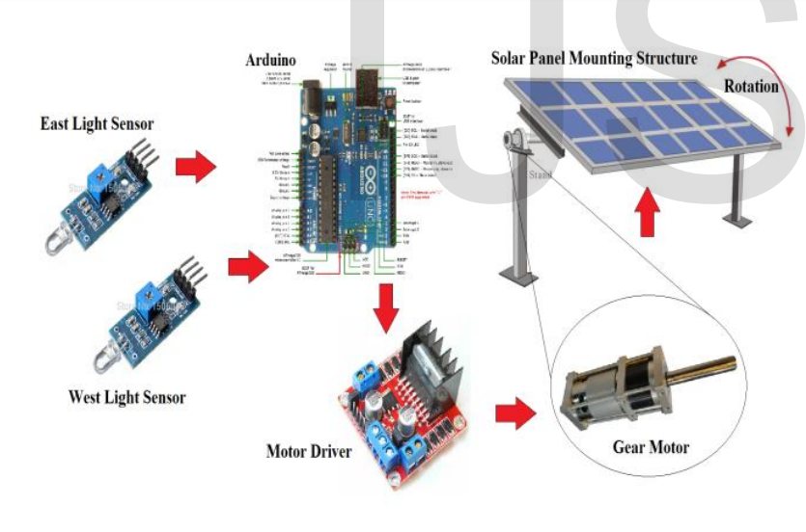
Block Diagram

Slide 6
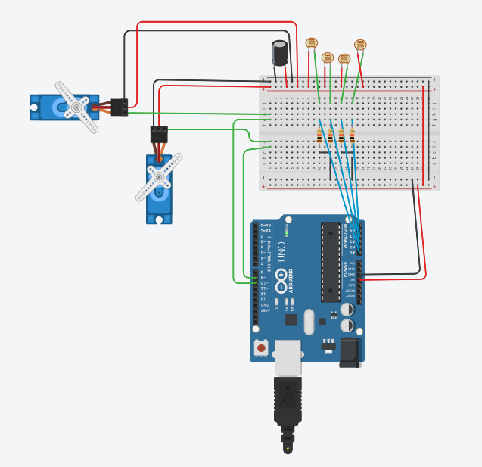

Tinkercad Circuit Diagram

Slide 7
CODE
#include <Servo.h>
//defining Servos
Servo servohori;
int servoh = 0;
int servohLimitHigh = 160;
int servohLimitLow = 20;
Servo servoverti;
int servov = 0;
int servovLimitHigh = 160;
int servovLimitLow = 20;
//Assigning LDRs
int ldrtopl = 2; //top left LDR green
int ldrtopr = 1; //top right LDR yellow
int ldrbotl = 3; // bottom left LDR blue
int ldrbotr = 0; // bottom right LDR orange

Slide 8
void setup ()
{
servohori.attach(10);
servohori.write(0);
servoverti.attach(9);
servoverti.write(0);
delay(500);
}
void loop()
{
servoh = servohori.read();
servov = servoverti.read();
//capturing analog values of each LDR
int topl = analogRead(ldrtopl);
int topr = analogRead(ldrtopr);
int botl = analogRead(ldrbotl);
int botr = analogRead(ldrbotr);

Slide 9
// calculating average
int avgtop = (topl + topr) / 2; //average of top LDRs
int avgbot = (botl + botr) / 2; //average of bottom LDRs
int avgleft = (topl + botl) / 2; //average of left LDRs
int avgright = (topr + botr) / 2; //average of right LDRs
if (avgtop < avgbot)
{
servoverti.write(servov +1);
if (servov > servovLimitHigh)
{
servov = servovLimitHigh;
}
delay(10);
}

Slide 10
else if (avgbot < avgtop)
{
servoverti.write(servov -1);
if (servov < servovLimitLow)
{
servov = servovLimitLow;
}
delay(10);
}
else
{
servoverti.write(servov);
}
if (avgleft > avgright)
{
servohori.write(servoh +1);
if (servoh > servohLimitHigh)

Slide 11
{
servoh = servohLimitHigh;
}
delay(10);
}
else if (avgright > avgleft)
{
servohori.write(servoh -1);
if (servoh < servohLimitLow)
{
servoh = servohLimitLow;
}
delay(10);
}
else
{
servohori.write(servoh);
}
delay(50);
}

Slide 12
ADVANTAGE
Trackers generate more electricity than their stationary counterparts due to increased direct exposure to solar rays.
Solar trackers generate more electricity in roughly the same amount of space needed for fixed-tilt systems, making them ideal for optimizing land usage.
Advancement in technology and reliability in electronics and mechanics have drastically reduced long ter0m maintenance concerns for tracking systems
DISADVANTAGE
Solar trackers are slightly more expensive that their stationary counterparts, due to the more complex technology and moving parts necessary for their operation.
Trackers are a more complex system than fixed racking.
Single-axis tracker projects also require an additional focus on company stability and bankability.

Slide 13
APPLICATION
Solar Photovoltaic plants require continuous orientation towards sun for consistent efficiency output. This product will prove a great boon for them.
Solar water heating applications can also implement the same technique to heat water throughout the day.
Concentrated applications like concentrated photovoltaic panels require a high degree of accuracy to ensure the sunlight is directed precisely at the focal point of the reflector or lens.
Non concentrating applications do not require tracking but using a tracker can improve the total power produced by the system.
Photovoltaic systems using high efficiency panels with trackers can be very effective.

Slide 14
WORKING
There are two light sensing modules. One for East and the other for West.
Both the sensors send digital information about presence and absence of light intensity to the Micro controller.
The micro controller decides the output signals for the motor driver so as to drive the motor in CW or ACW direction.
The motor driver module receives the signals from the micro controller and drives the motor in the specified direction with the specified speed.
The motor in turn controls the orientation of the solar panel mounting structure. Thus maintaining constant exposure to sunlight throughout the day.
FUTURE SCOPE
As the proposed prototype is a miniature of main system, it has some limitations which can be mitigated through future developments. A small cardboard is rotated in the system and 12v solar panel is used for analysis. As a miniature system, it works out well. Larger Solar panel must be integrated with the system to prepare better result and cost analysis. It has been proven through our research and statistical analysis that solar tracking system with single-axis freedom can increase energy output by approximately 20%.Further mechanical enhancement can be done to the prototype, to implement dual-axis tracking.

Slide 15
CONCLUSIONS
An Arduino solar tracker was designed and constructed in the current work. LDR light sensors were used to sense the intensity of the solar light occurrence on the photo-voltaic cells panel. Conclusions of this project is summarized as ,the existing tracking system successfully sketched the light source even it is a small torch light, in a dark room, or it is the sun light rays. The cost and reliability of this solar tracker creates it suitable for the rural usage. The purpose of renewable energy from this paper offered new and advanced idea to help the people

Slide 16
Thank You

